Slide 1
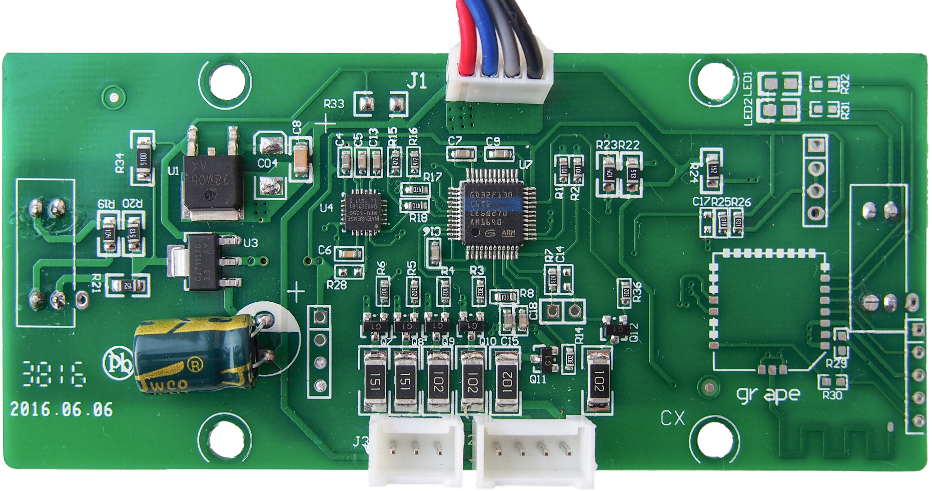
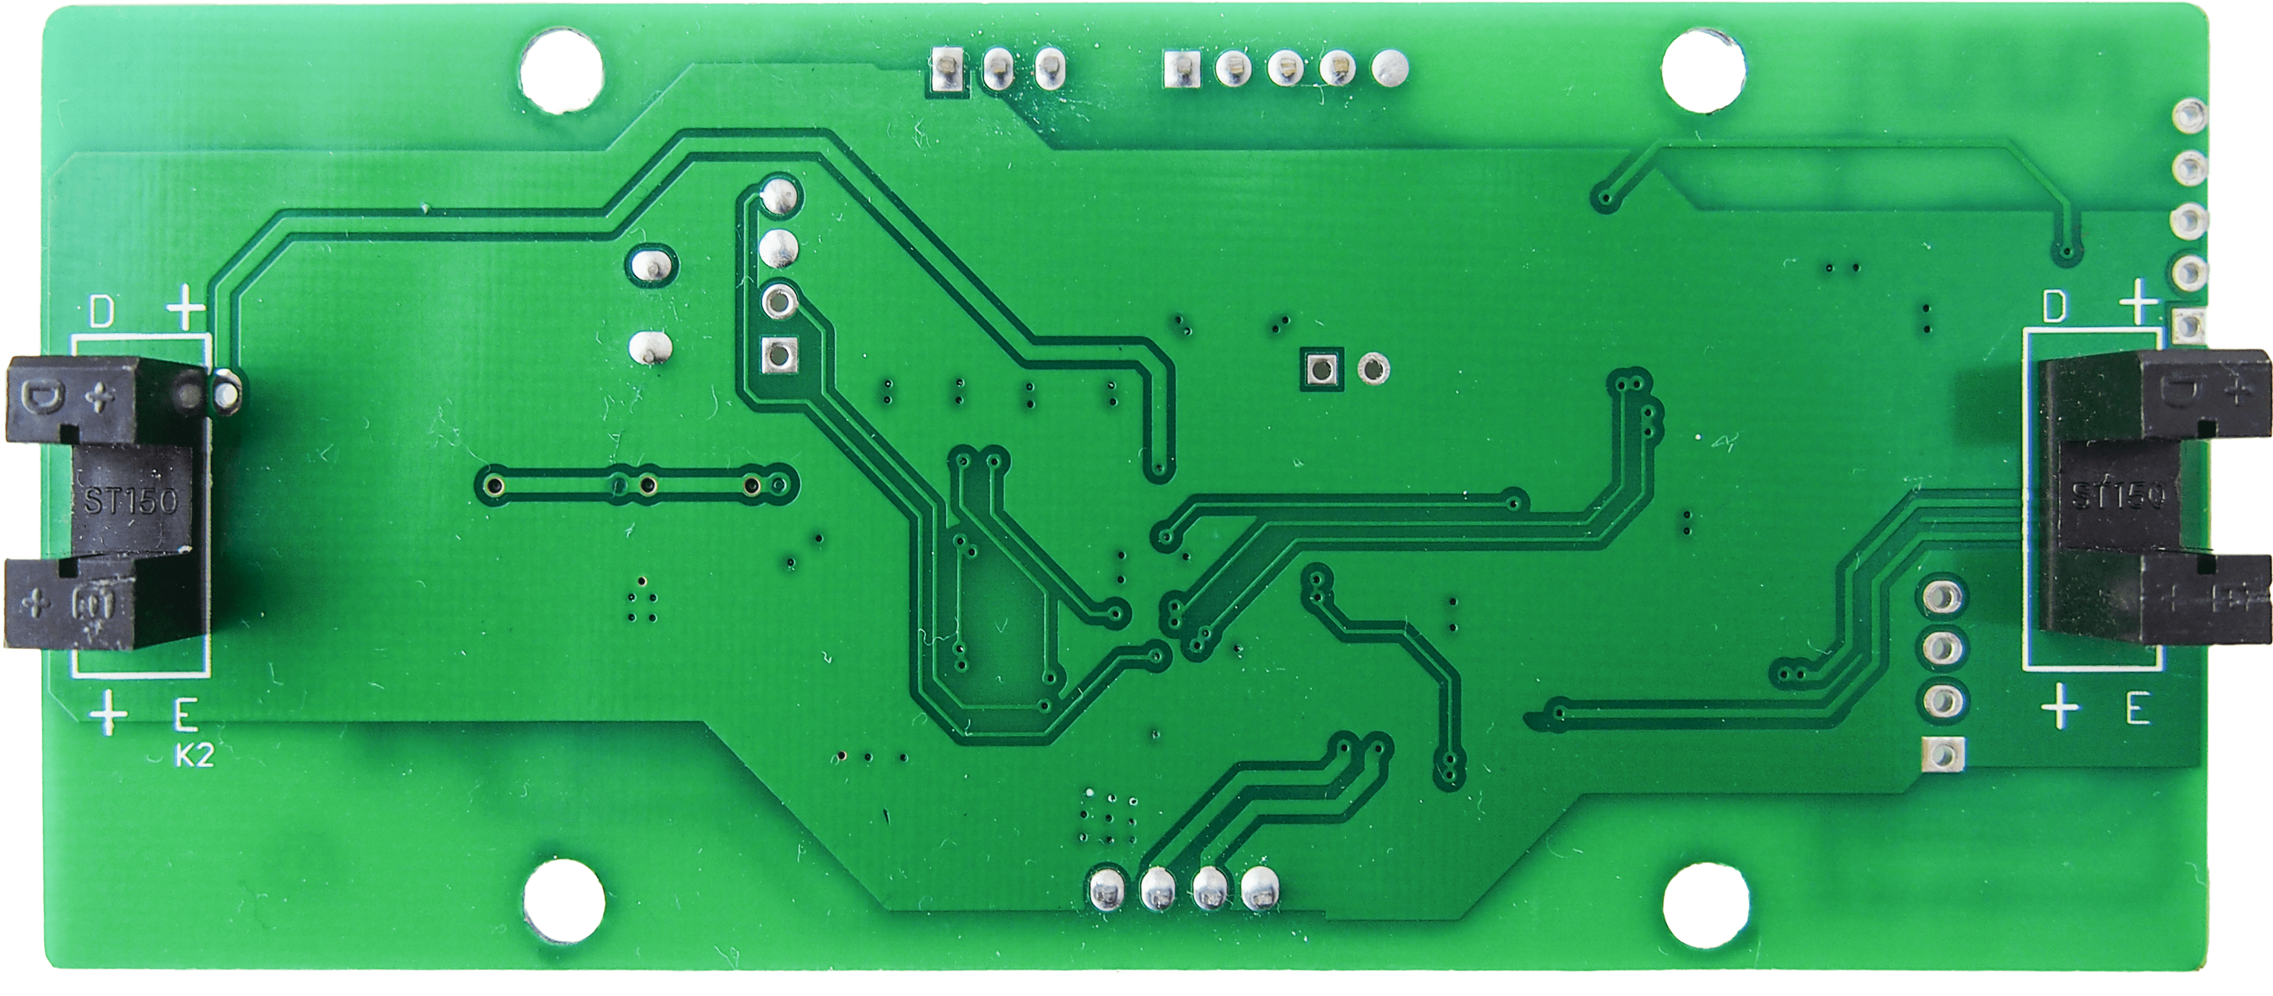
IMU MPU-6050
Main Board
PB6 / MPU_SCL
GND
PA2 / TX
PA3 / RX
PB7 / MPU_SDA
VDD 15V
RF Module HFY-J18
(optional)
GND
PC15 / AUX1_PU
PC15 / AUX1_PU
VDD 5V
PC14 / SENSOR2
PA4 / SENSOR1
SWD Programming
PA10 / AUX4/RX/SDA
VDD 3.3V
PA9 / AUX5/TX/SCL
PA14 / SWCLK
GND
GND
PA13 / SWDIO
PA1 / AUX2
LED Boards
PB10 / AUX3
PA0 / LED1
PB9 / LED2
PB8 / LED3
PB5 / LED4
VDD 15V
PB4 / LED5
VDD 15V

